Slide 1




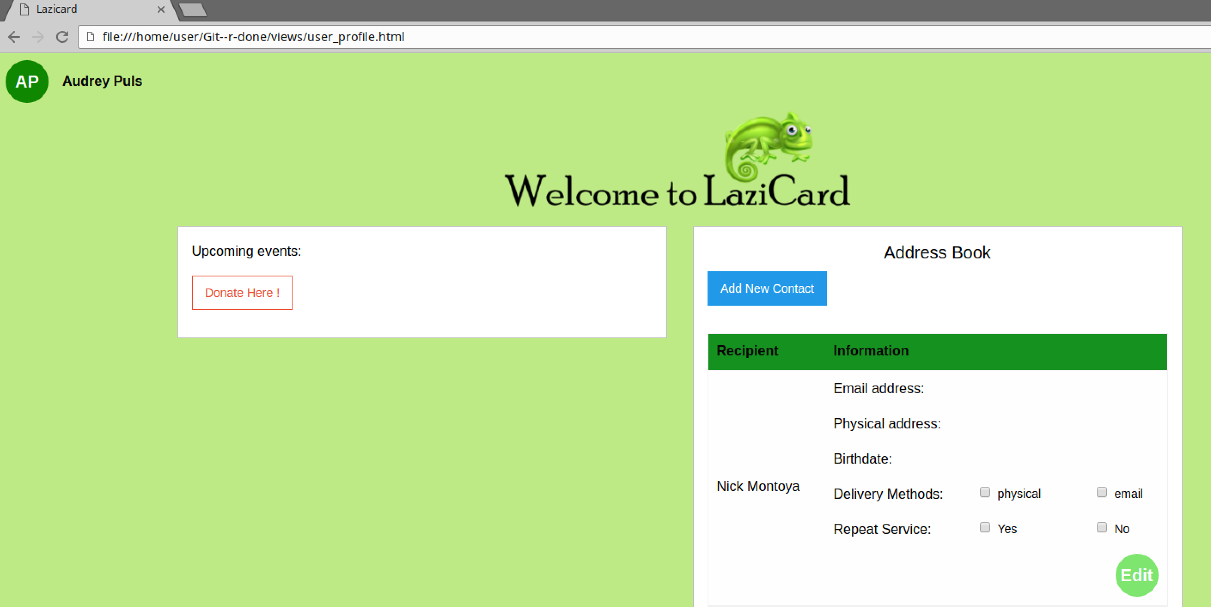
Welcome to LaziCard
Team Number: 17
Team Name: Git –R Done
Vision Statement: To ensure birthdays are never forgotten
Birthday card Delivery Service
Focus on being lazy(easy for customer) by auto generating cards
Members: Audrey Puls, Dan Schwabacher, Nick Montoya, Yifan Li, Ruiwen Jin, Le Qin

Slide 2


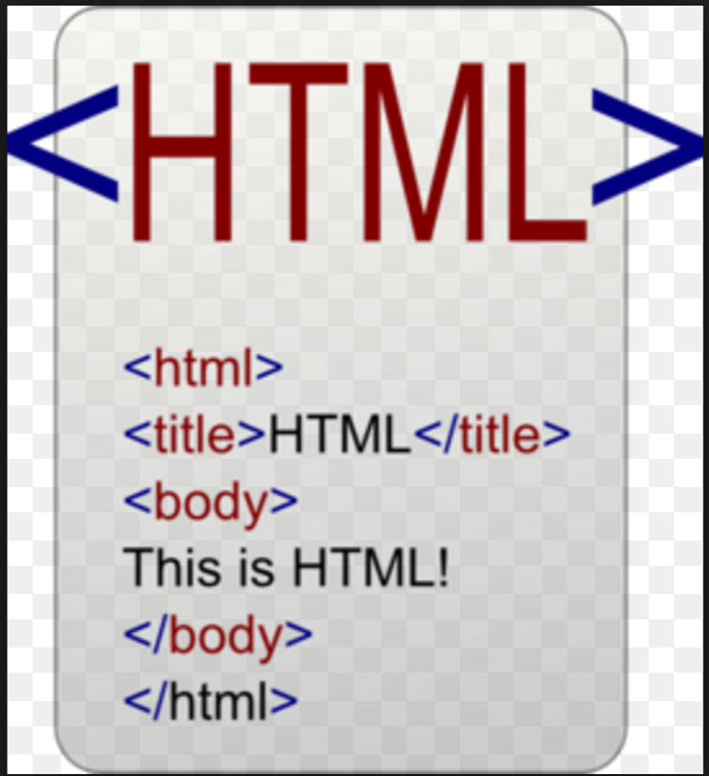


Framework and Three Week Sprint
Django -> Node
MySQL-> Mongo dB
HTML
Foundation
Slack
Trello
Frontend and Backend Complete
User page
Login Page

Slide 3
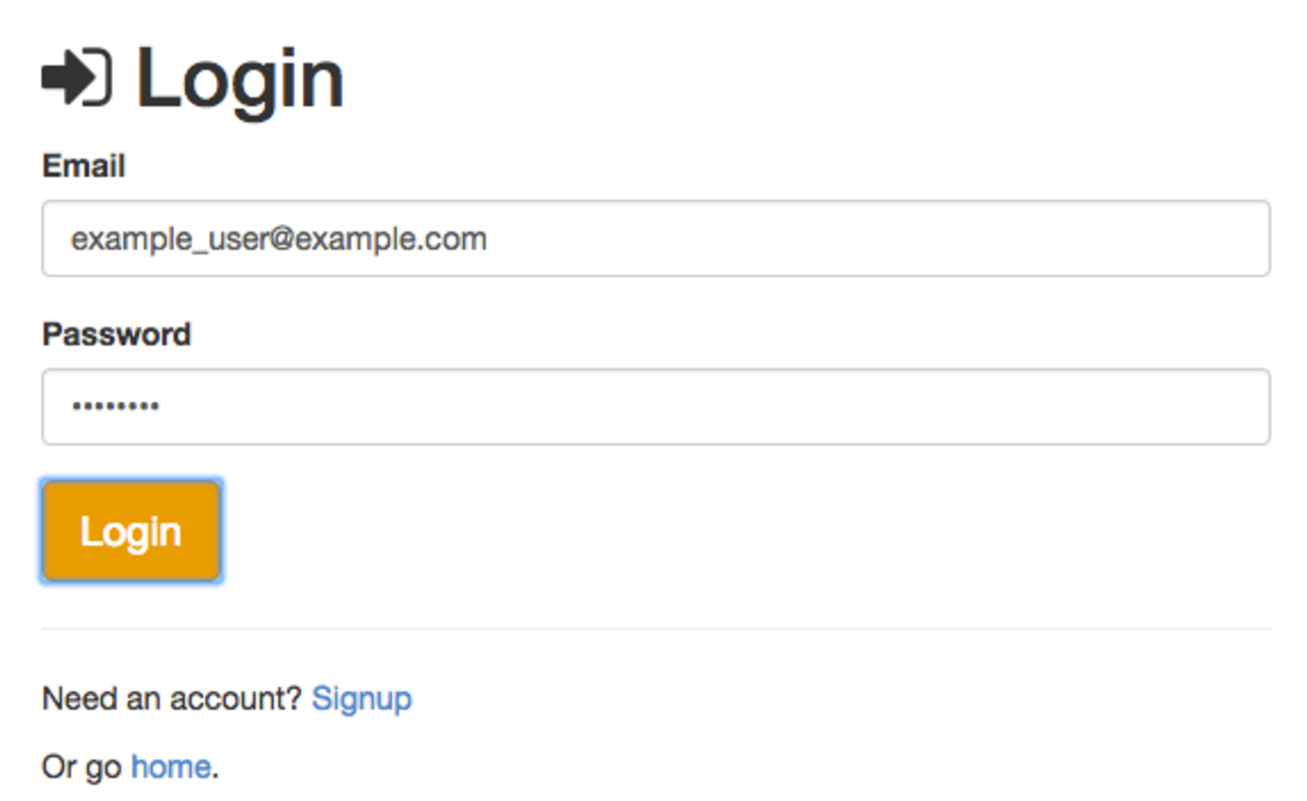

Account Information
Login Page
Home Page
Passport

Slide 4


Database
Mongo dB
3 collections
10 users
10 contacts each

Slide 5
Market Analysis
Auto generated cards based on gender=less work for the user
Large target market
Competitors are Blue Mountain, Card Store, and Funky Pigeon
No physical card delivery

Slide 6
Two Week Sprint
Frontend and Backend Work On:
HTML for user home page
Linking HTML to user home page database

